Slide 1

ELECTRICAL PANEL
AS ELECTRICAL DRIVES & AUTOMATION
SOLUTIONS
Established 2015 | Noida, UP
10+
500+
PAN
Powering Industry with Precision, Safety & Innovation
Years Exp.
Projects
India
Manufacturer
Supplier
Exporter
Customized Solutions
www.aselectricalautomation.com

Slide 2





ABOUT US
Trusted Electrical Partner Since 2015
Who We Are
10+
AS Electrical Drives & Automation has been delivering reliable and innovative electrical solutions since 2015. We are a trusted manufacturer, supplier, and exporter of advanced electrical panels across India.
Years of Experience
Innovative system design & advanced automation integration
500+
Energy-efficient & robust panel construction
Panels Delivered
User-friendly interfaces with smart control
100%
Customized designs for every industry need
Quality Tested
Quick delivery with competitive pricing
PAN India
Service Coverage

Slide 3
OUR ELECTRICAL PANEL PRODUCTS
01
PCC Panel
02
MCC Panel
03
Power Distribution Panel
04
HVAC Electrical Panel
View Product →
View Product →
View Product →
View Product →
05
Main LT Panels
06
Load Management & Sync Panels
07
APFC Panels
08
AMF Panels
View Product →
View Product →
View Product →
View Product →
09
Relay & Generator Control Panel
10
UPS
11
Fire Fighting Panels
12
Ventilation Control System
View Product →
View Product →
View Product →
View Product →

Slide 4
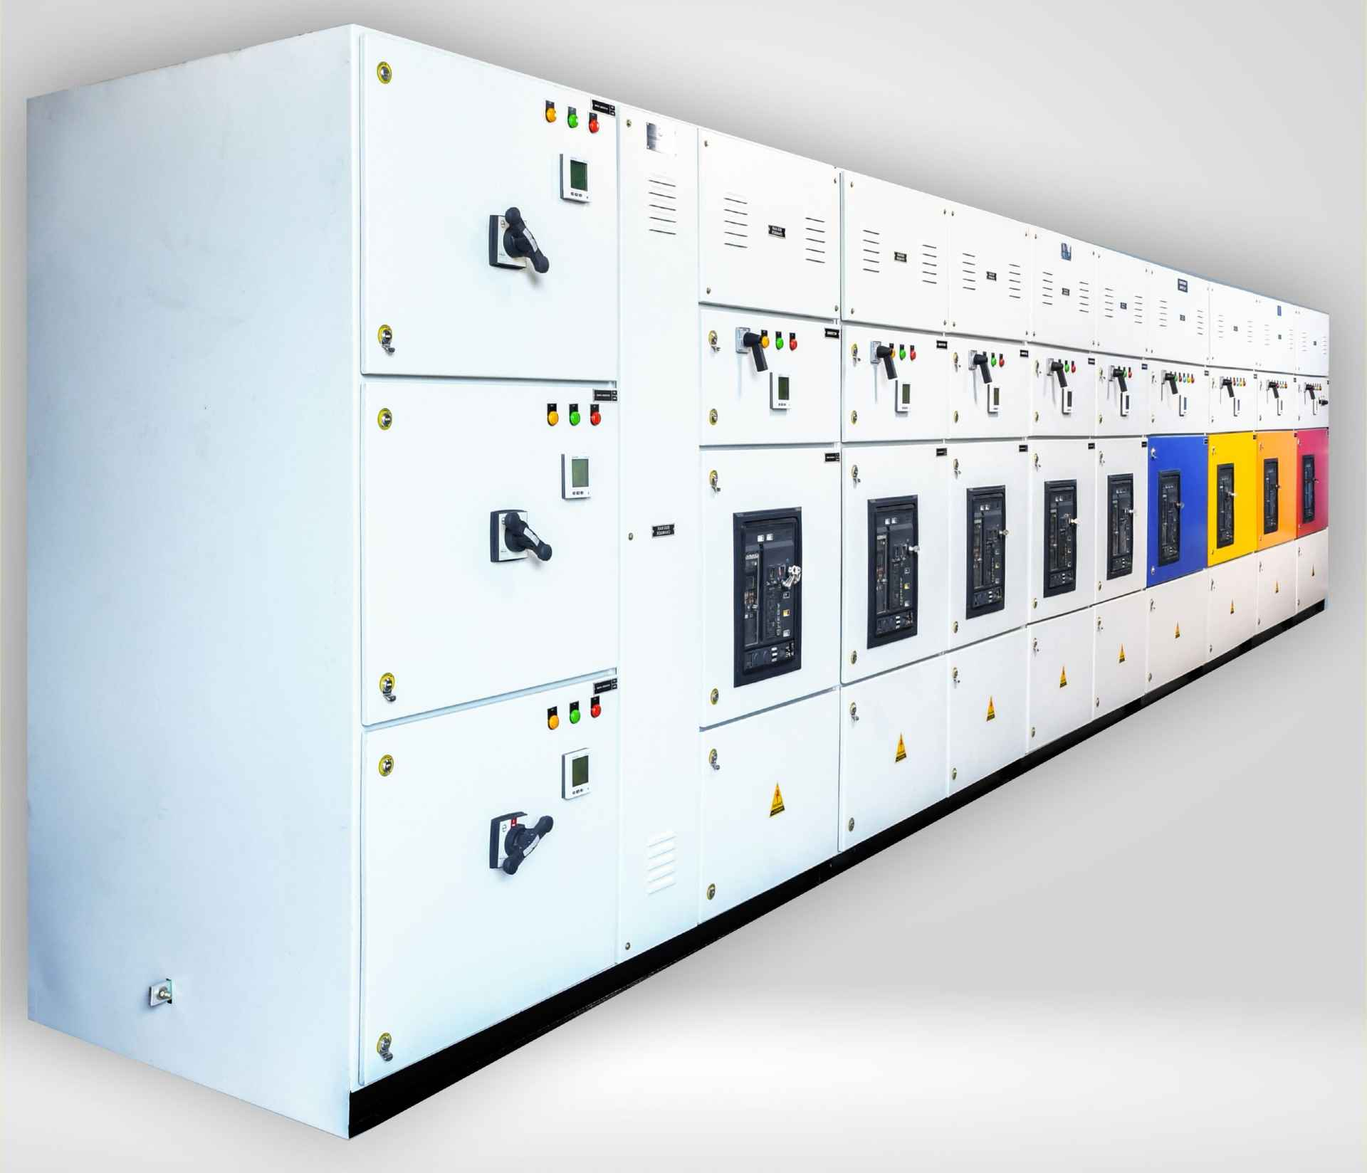
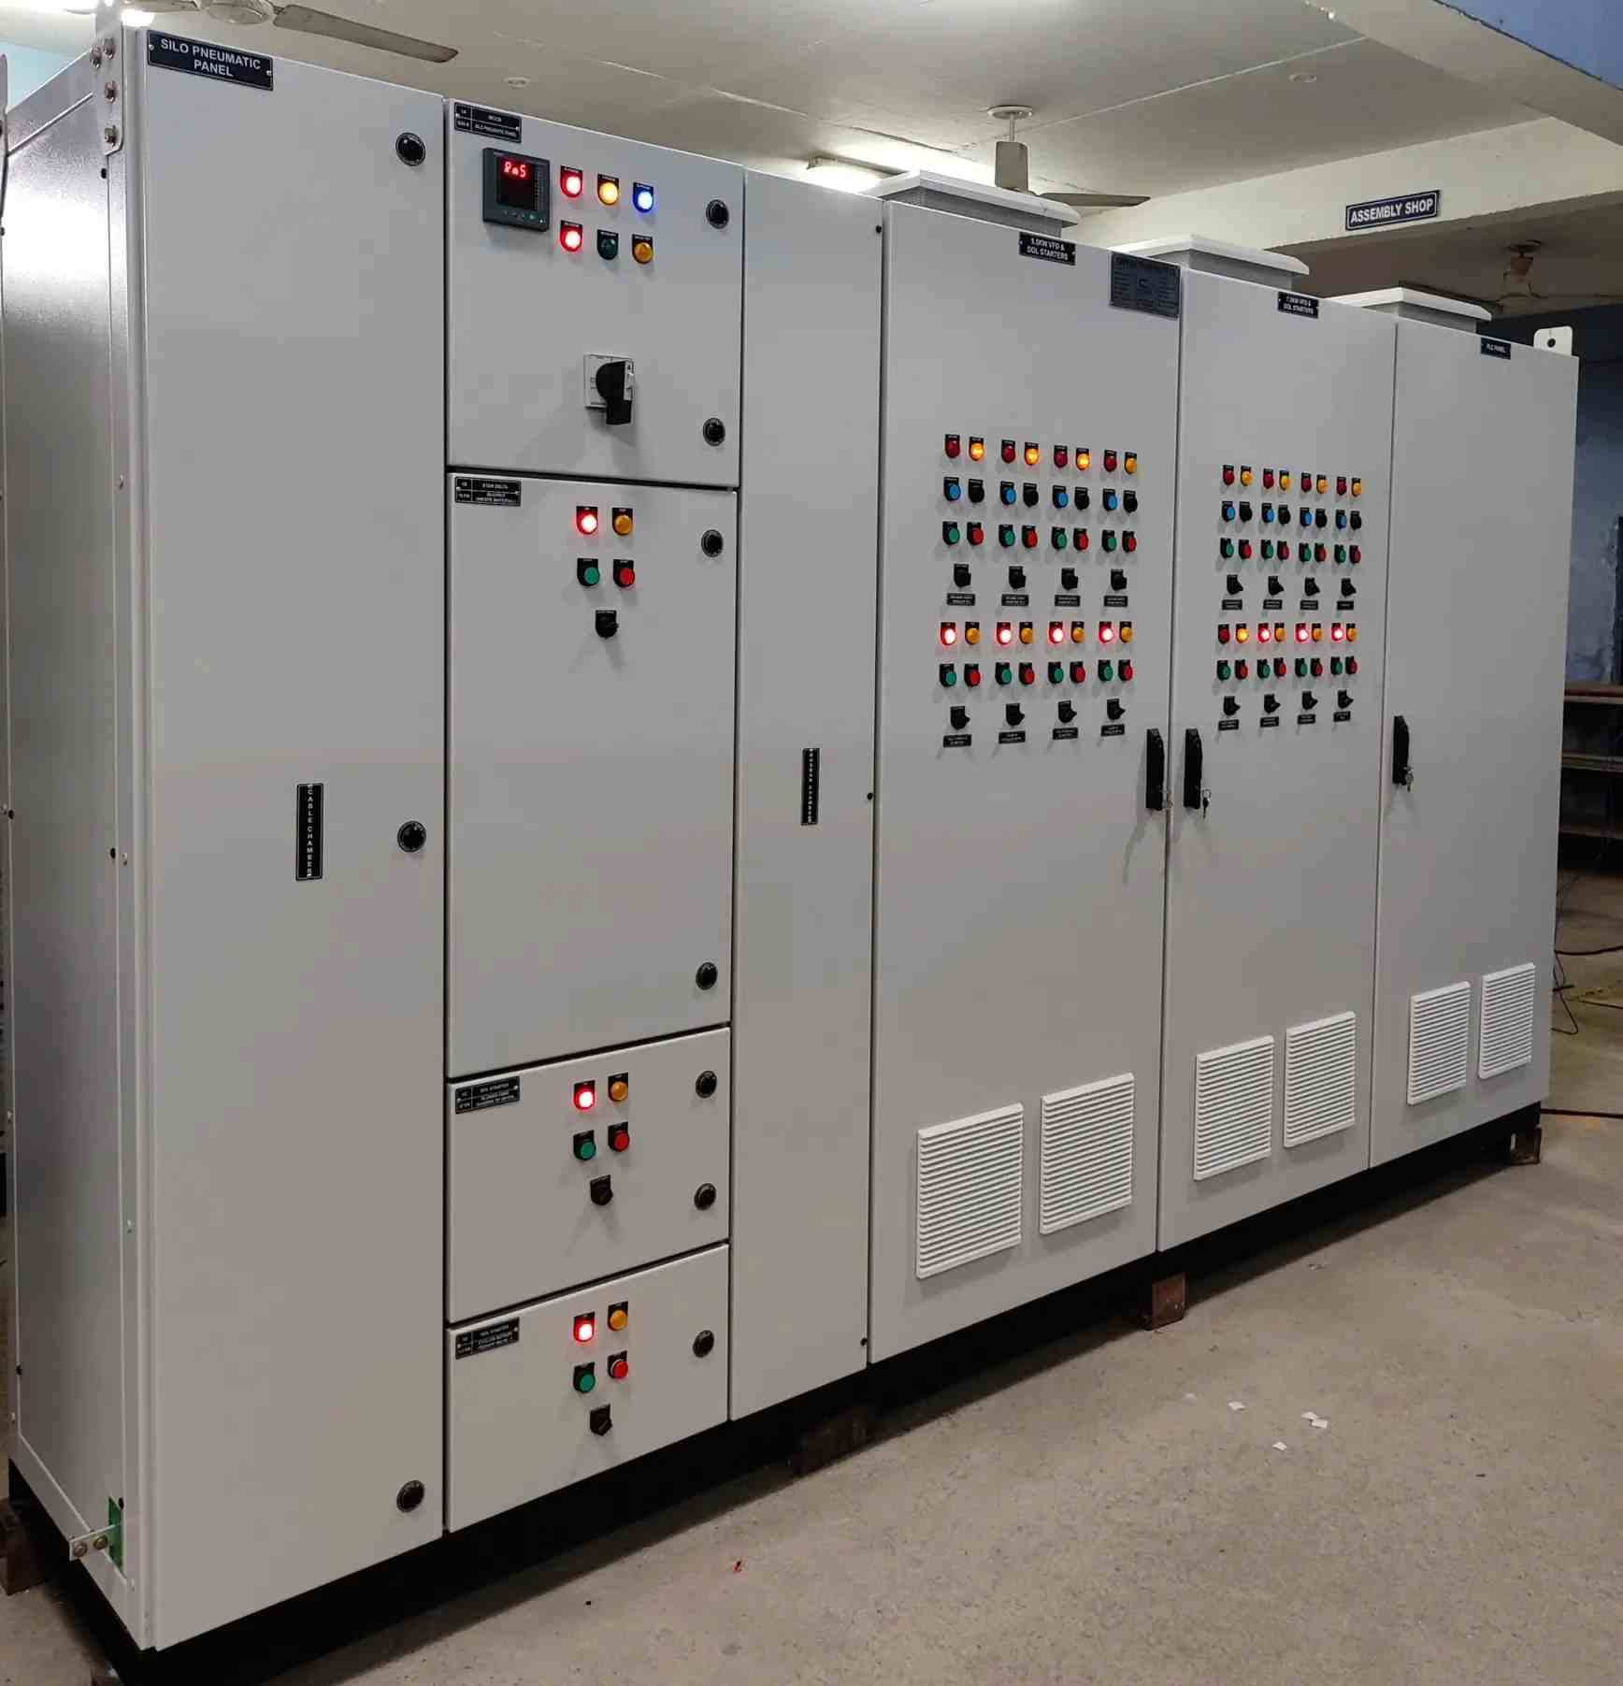
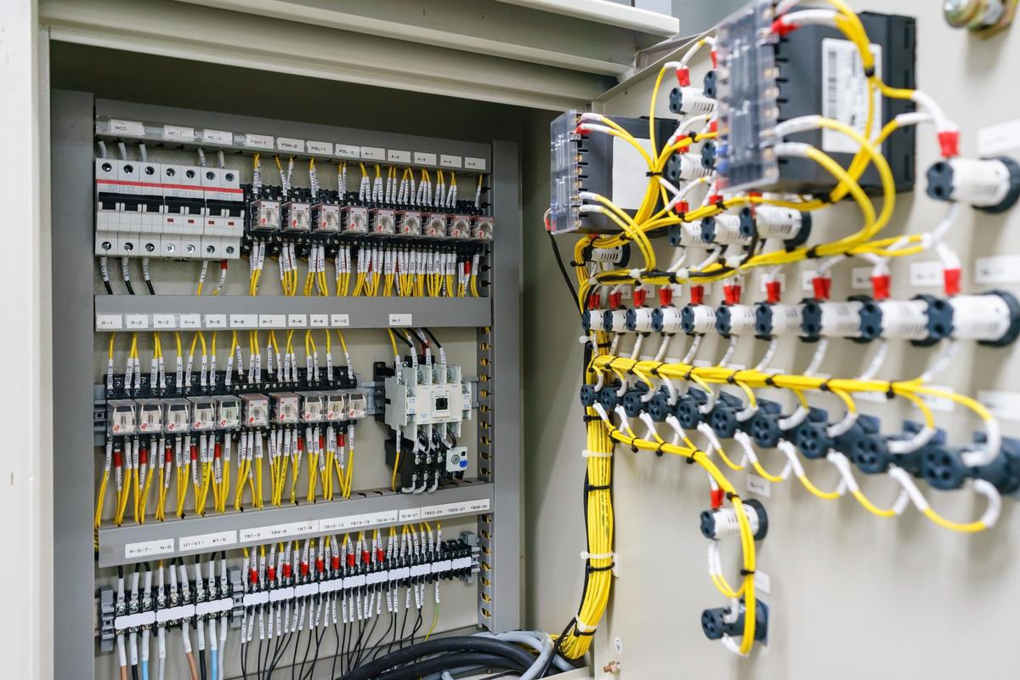
FEATURED PRODUCTS
PCC Panel
MCC Panel
PDP – Power Distribution Panel
Power Control Center – main power distribution hub for industrial plants
Motor Control Center – controls & protects electric motors in industrial setups
Efficiently distributes electrical power across industrial and commercial systems.

Slide 5
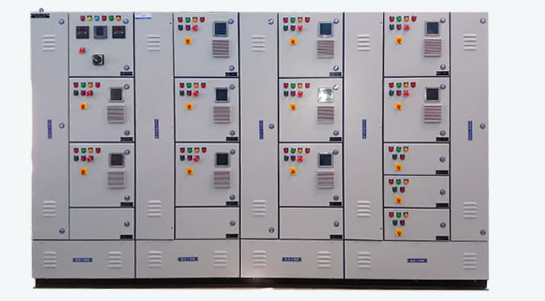
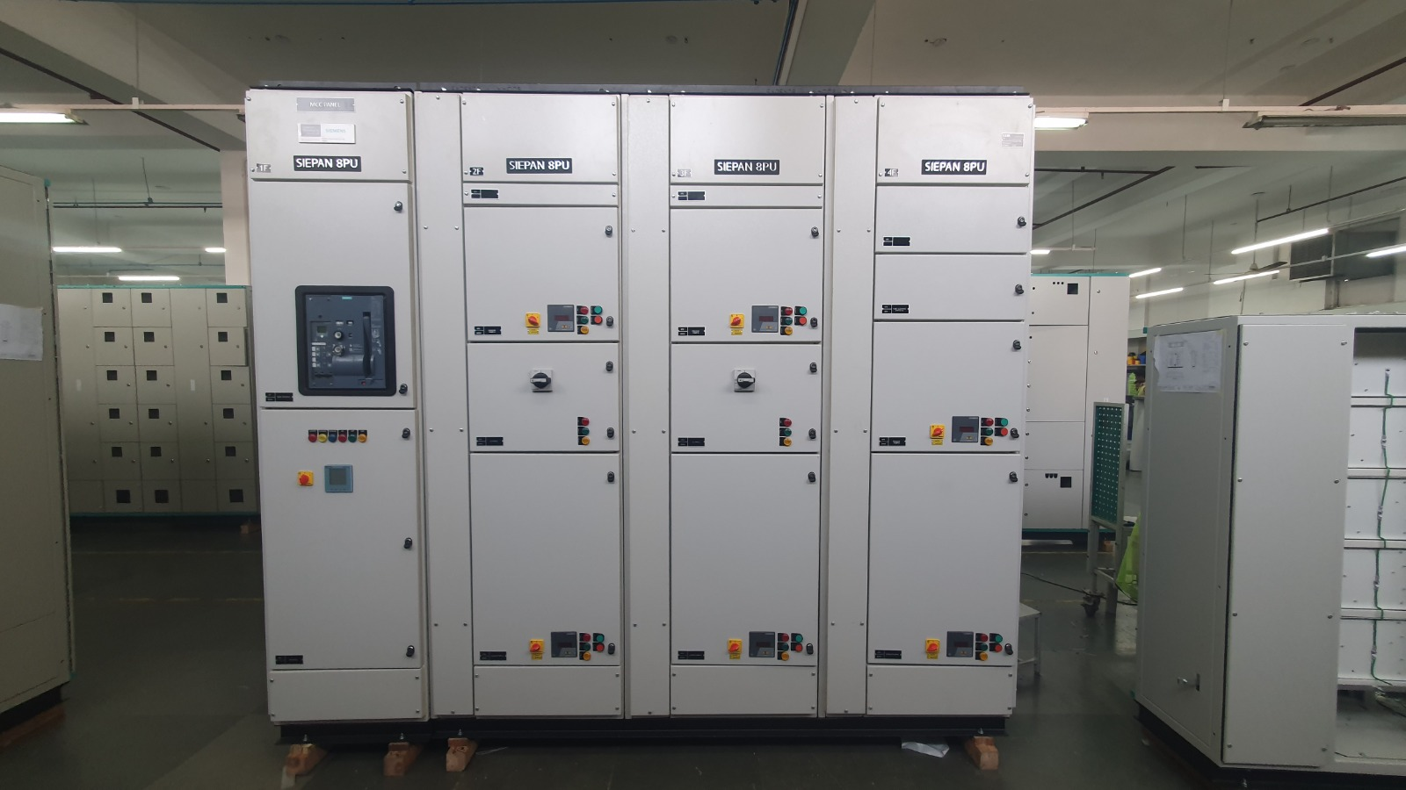
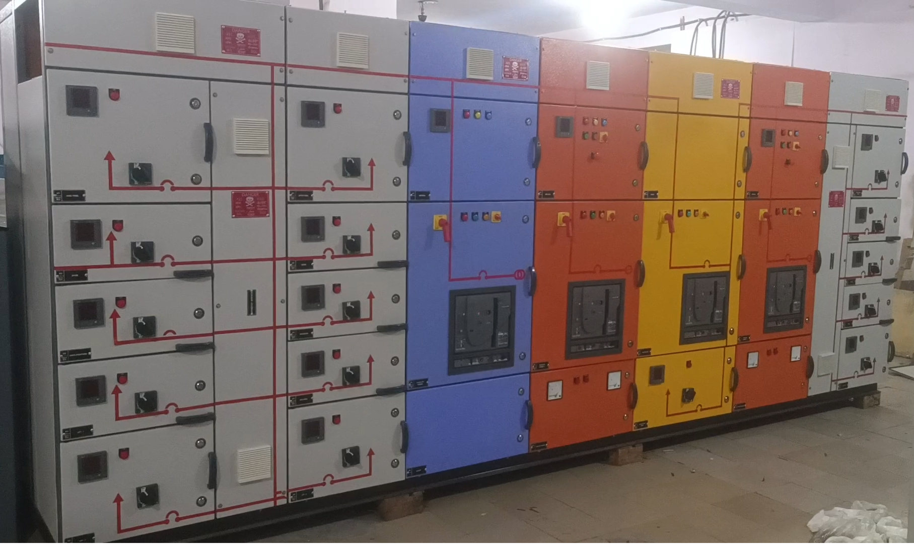
FEATURED PRODUCTS
HVAC Electrical Panel
Main LT Panels
Load Management & Sync Panel
Controls and manages HVAC system power and operations efficiently.
Centralized low-voltage power distribution and electrical system protection.
Balances electrical loads and synchronizes multiple power sources efficiently.

Slide 6
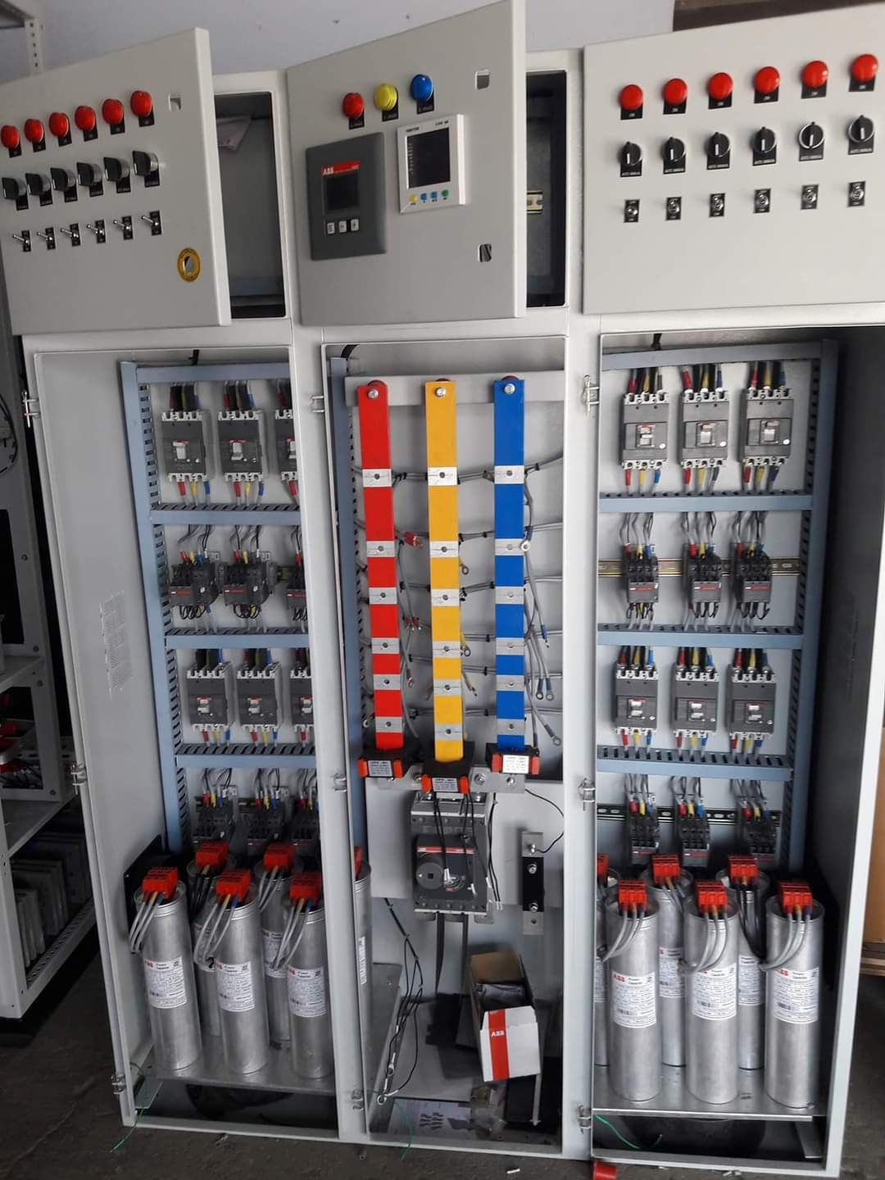
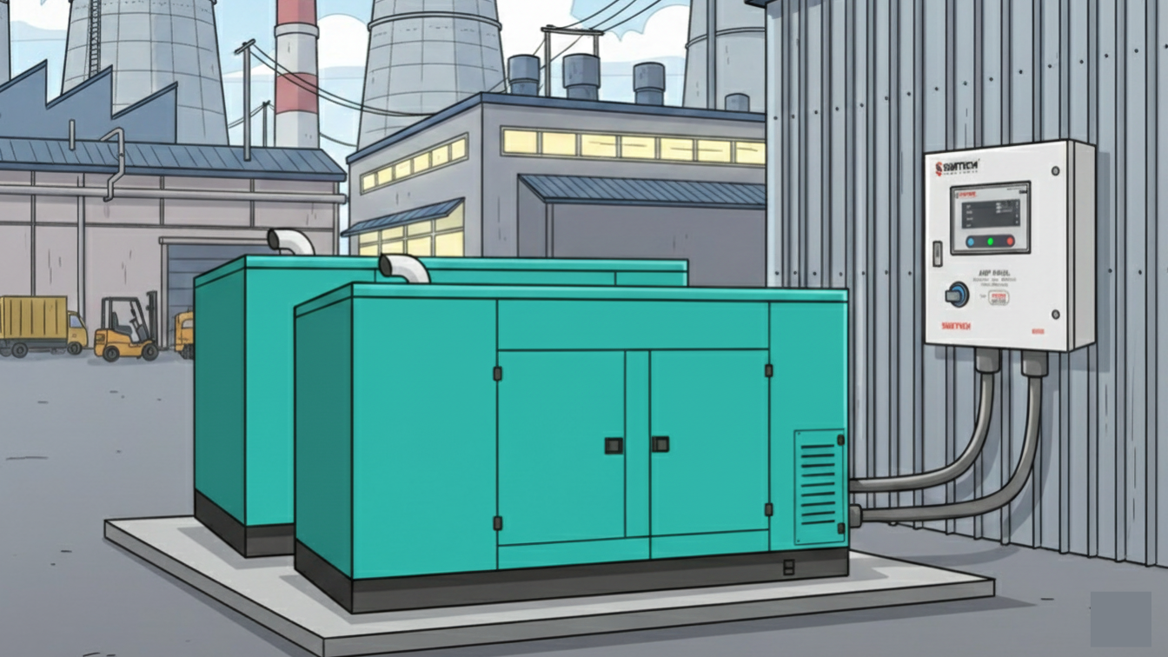
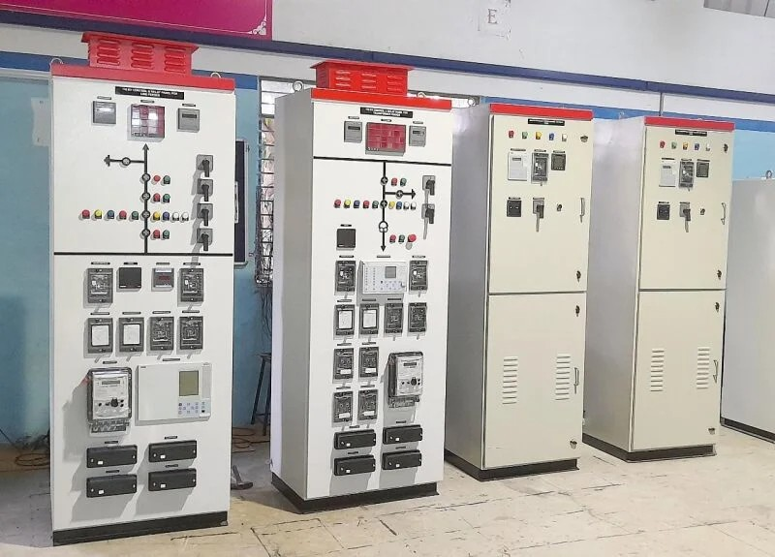
FEATURED PRODUCTS
APFC Panels
AMF Panels
Relay & Generator Control Panel
Automatic Power Factor Correction – improves energy efficiency & reduces bills
Automatically switches power during mains failure and restoration.
Monitors, protects, and controls generator and relay operations.

Slide 7
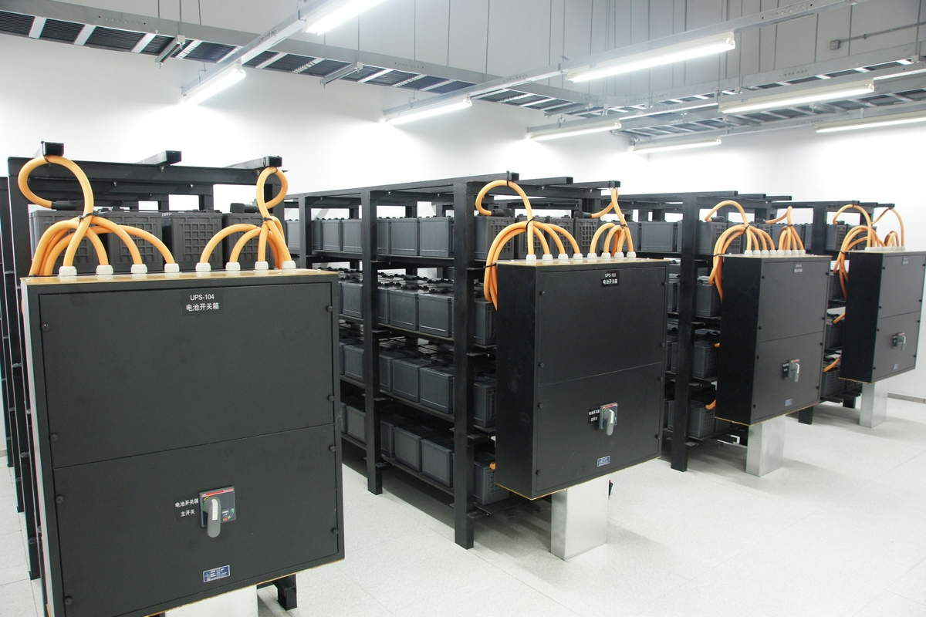
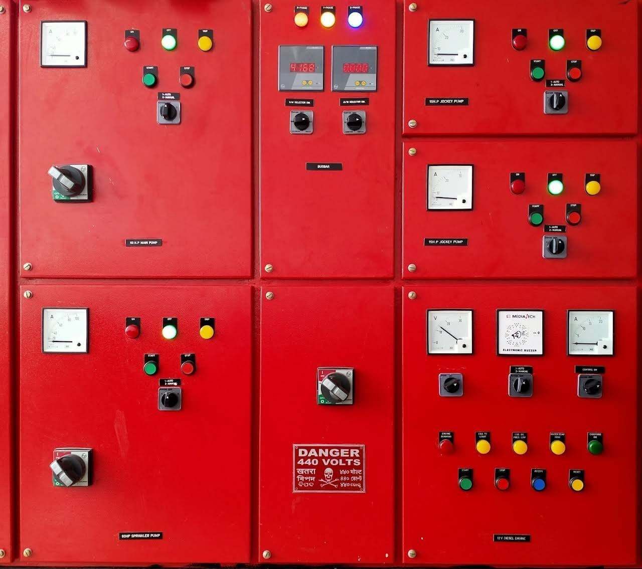
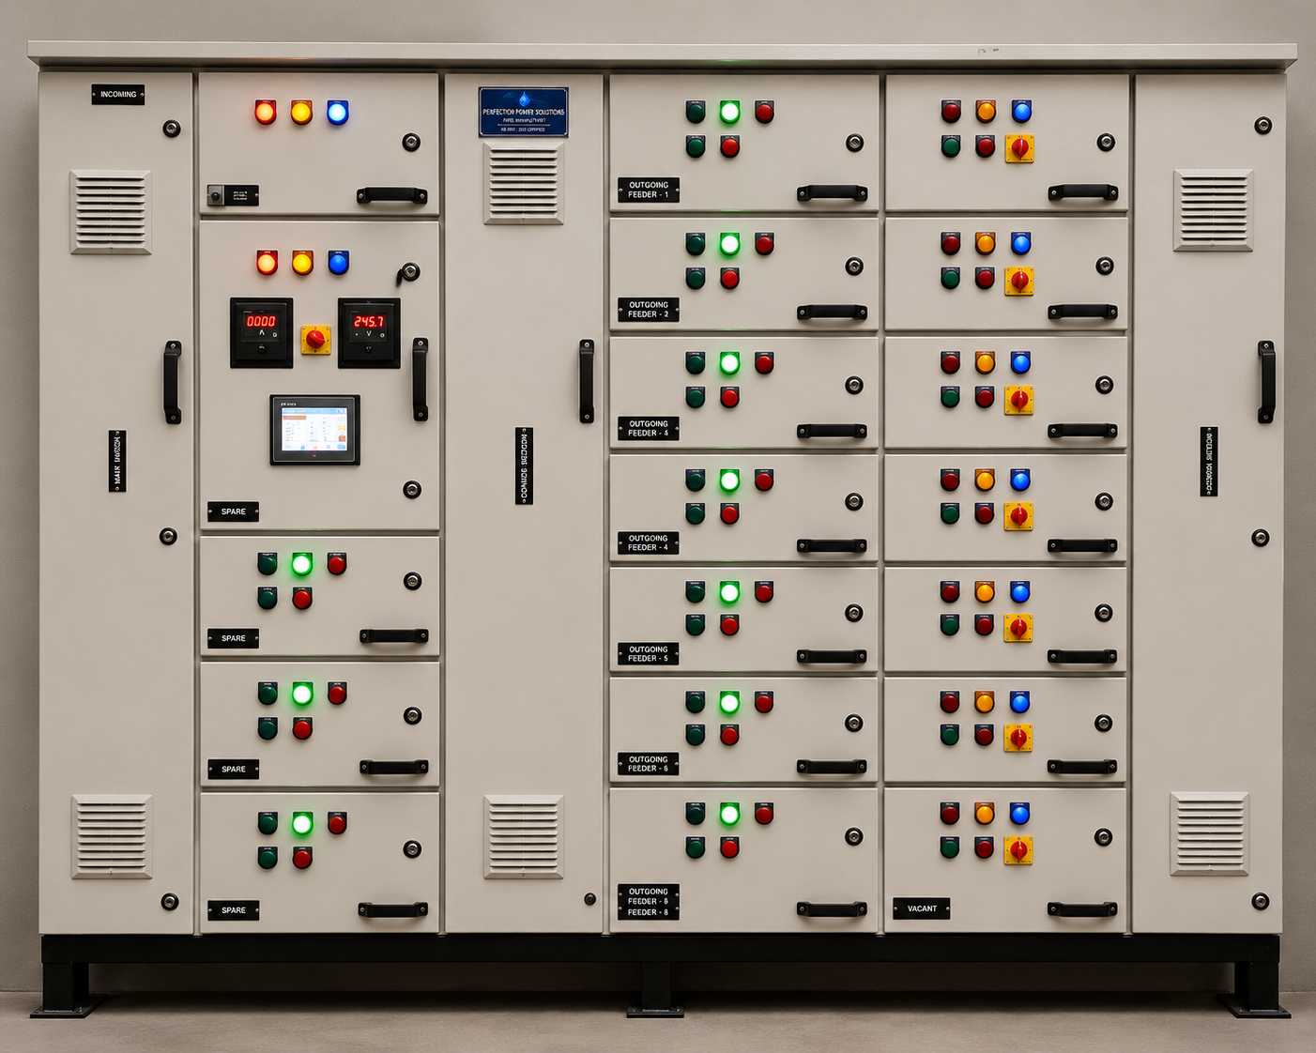
FEATURED PRODUCTS
UPS - Uninterruptible Power Supply
Fire Fighting Panels
Ventilation Control System
Provides continuous backup power during electrical interruptions and outages.
Controls and monitors fire protection and fire fighting systems efficiently.
Controls airflow and maintains safe, efficient ventilation operations.

Slide 8

WHY CHOOSE US?
10+ Years Experience
End-to-End Solutions
Fully Customized
Decade-long expertise in industrial electrical panel manufacturing and delivery
From design to installation – complete electrical control panel solutions under one roof
Panels designed per load, automation needs, and industry-specific configurations
Quality Assured
PAN India Delivery
Competitive Pricing
Every panel rigorously tested with premium-grade components for safe, long-lasting performance
Manufacturer, supplier & exporter serving clients across India with quick turnaround
Best-in-class pricing without compromising on quality, safety, or performance

Slide 9



CONTACT US
Ready to power your business? Get in touch with our expert team for customized electrical panel solutions.
AS ELECTRICAL DRIVES
& AUTOMATION
Phone
+91 96671 19369
Powering Industry with Precision, Safety & Innovation
Email
info@aselectricalautomation.com
Address
H-119, F04A, First Floor, Sector 63, Noida, UP 201301
12 Electrical Panel Solutions | Established 2015
www.aselectricalautomation.com

